Slide 1
Introduction to Linux and Scripting
Summer Program 2023
Alexander Heide

Slide 2
This Talk’s Goal
To provide a readable, reviewable reference for brand new / novice linux users. I have rST docs as well that covers some of this material
To be a quick overview of many of the non quantum chemistry specific, but very useful, general tools of linux
To give you a hint of how linux could make your life easier if you learn it
For the six hour long full tutorial: freeCodeCamp

Slide 3
Learning Objectives
Be comfortable with basic linux usage
navigating, permissions, and basic commands
Have a basic understanding of the fundamental tools of Linux
git, grep, systemd, vim
Know how to install packages with
package managers and conda
Know how our clusters work
software loading, submission process
bash
Know what to do when you don’t know what to do -h / –help

Slide 4
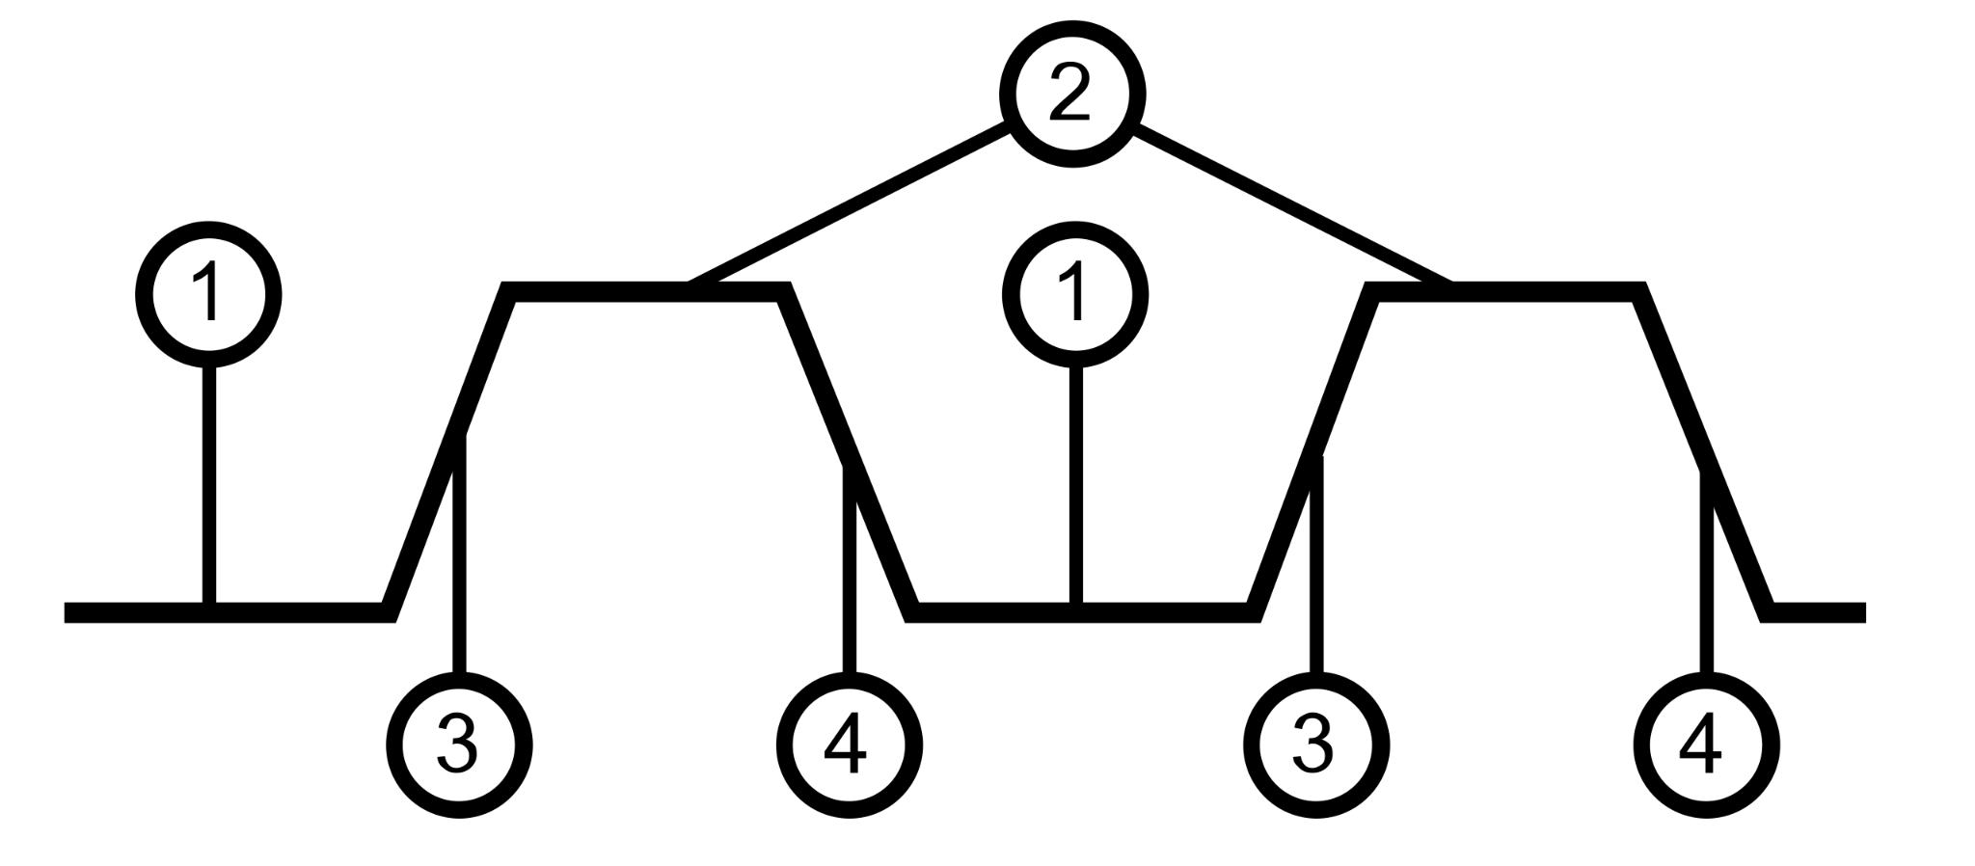
What is a Computer?
A computer consists of:
Central Processing Unit
An interconnect system (Bus)
data storage
Cache
Memory
Hard-drives
I/O devices
Keyboard
Screen
network connections
Hard-drives
Information is encoded in an electrical signal and a series of electrical switches or gates can perform operations on a set of electrical signals
https://en.wikipedia.org/wiki/Digital_signal

Slide 5
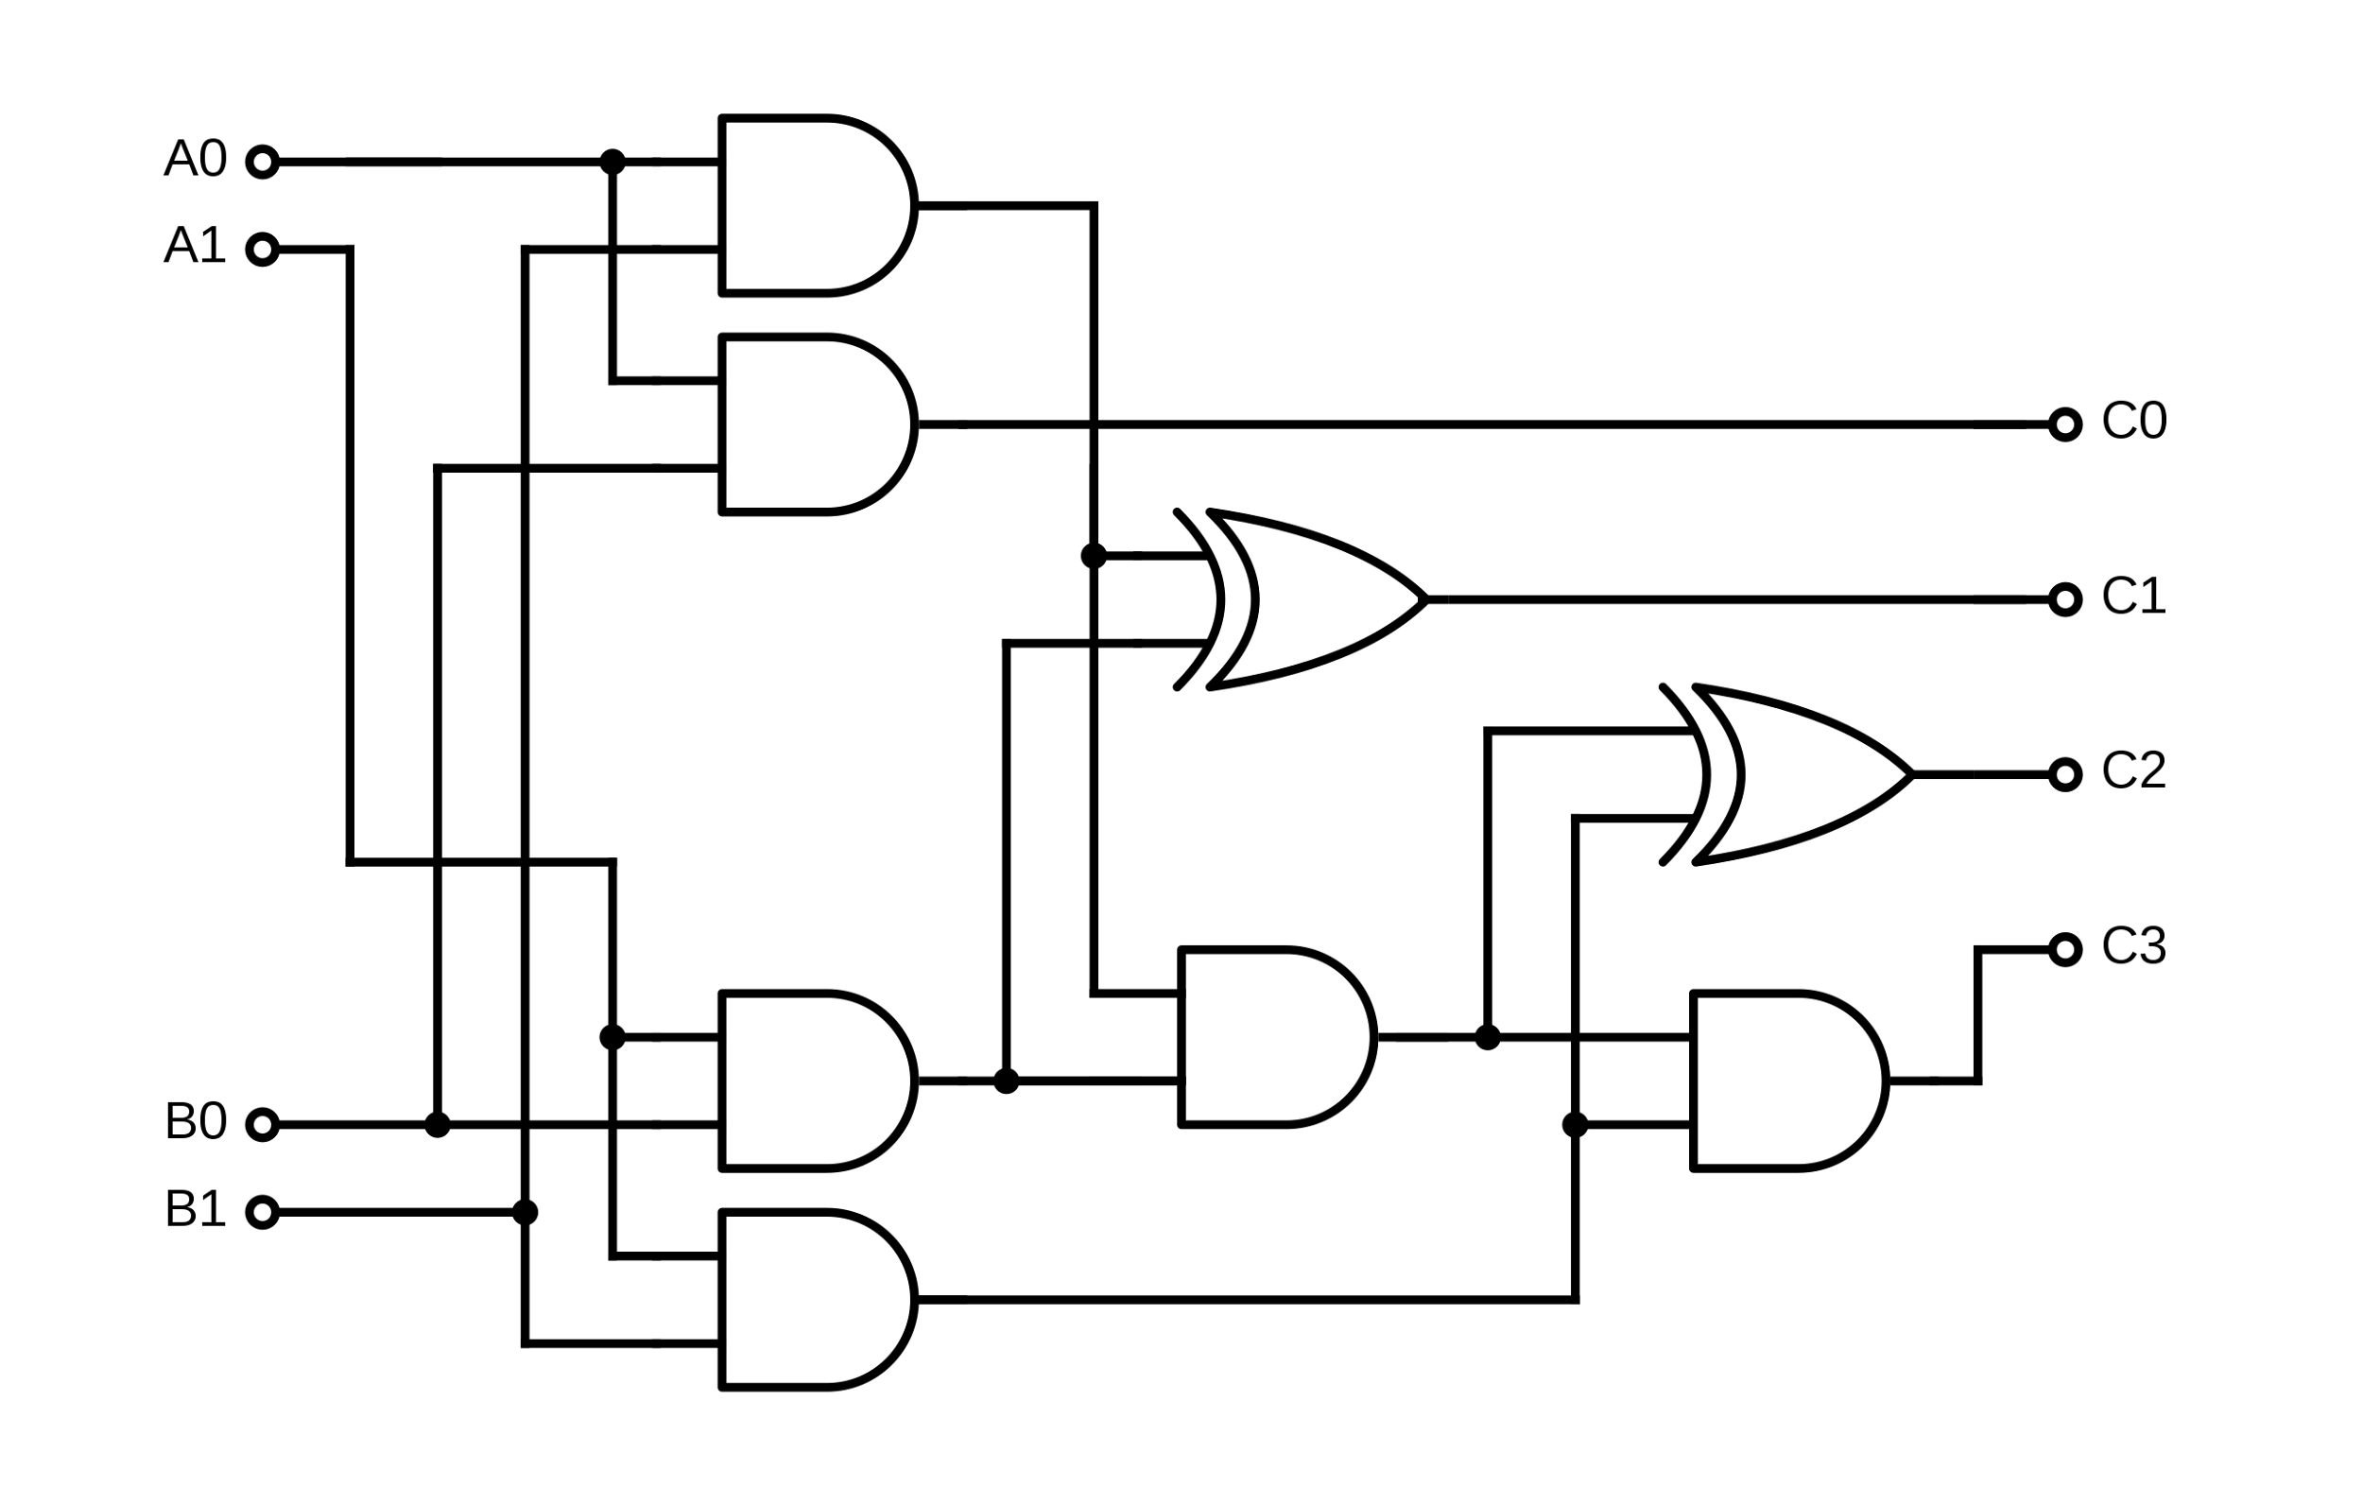
A Simple Multiplication Operator
Consists of AND Gates and two XOR (exclusive or)

Slide 6
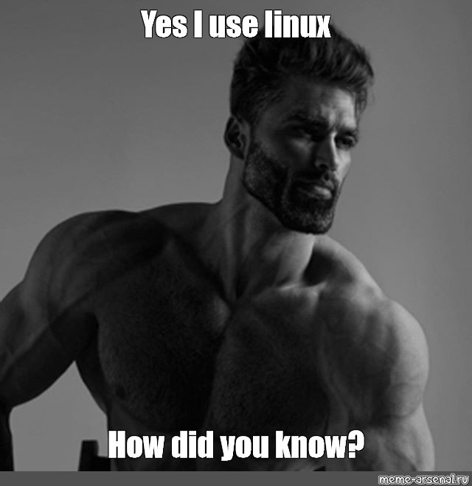

Slide 7
A Summary of Linux and Its History
Linux is a Unix-like kernel and a family of operating systems built from that kernel
Linux is primarily written in C with small amounts of Rust recently added
Linux is the most rigorously security tested operating system on the planet
Linux/Unix is the defacto operating system / kernel for servers. Fully configurable, fast, and secure.
~6000 contributors and 27.8 million lines of code (on GitHub)
UNIX and C programming language
Developed at AT&T Bell Labs by Ken Thompson, Dennis Ritchie, and others
Linux
A small GPL kernel is developed as a hobby project by Linus Torvalds
1985
2023
1969-1973
1991
FSF and GNU
Richard Stallman begins the Free Software Foundation and GNU’s not Unix. Beginning of open-source software (GPL)
Linux Kernel 6.3.3
The Linux Kernel is the largest software project in the world.

Slide 8
What is an Operating System and Kernel ?
An operating system consists of the basic software to use a computer. This includes software to manage users, allow for physical input and output, a graphical user interface, basic utilities like file management, etc…
The core of an operating system is the Kernel. The Kernel layer provides an interface to the hardware/firmware of the physical computer, performs process scheduling, manages memory allocation (and security!), and more!

Slide 9
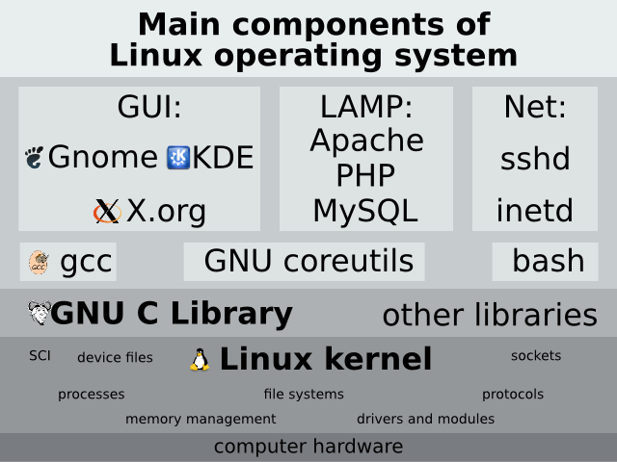
Kernels, Operating Systems, and Distros. Oh My!

Slide 10
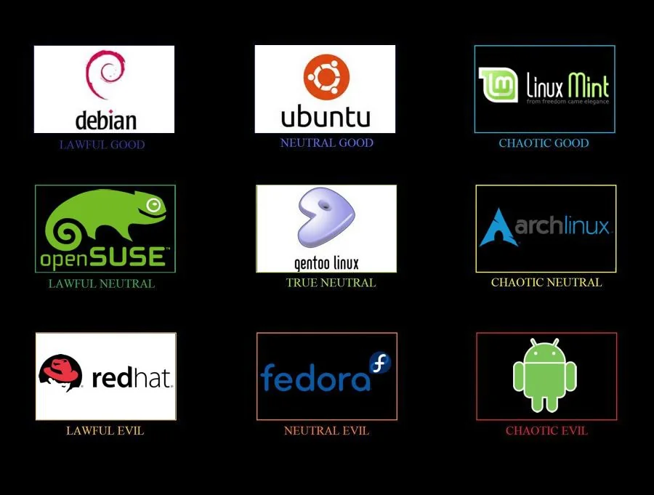
Kernels, Operating Systems, and Distros. Oh My!

Slide 11
Key Components of Linux - The Filesystem and Shell

Slide 12
Exploring the Filesystem Hierarchy Standard
Not unique to Linux. The ancestor of the FHS is found in Unix. Adopted by many operating systems today
Everything in Linux is a file - even directories and GPUs!
Establishes many common directories
/home - your area, no one else’s.
/root - admin’s home
/bin - system binaries (executables)
/lib - system source code, headers, .so files
/etc - system wide config files
/sys - OS and kernel libraries
/opt - optional (good install location)
/usr - global user space for installing
bin
lib
/dev - devices: hard drives, gpus, network adaptors
…

Slide 13
Shells in Linux - Some Basic Usage
Shells are processes from which you can interact with the system and run your own applications. There are login shells from which all of your processes (applications, commands, and other shells) are started. Every time you open a terminal you create a new and independent interactive shell.
There are many shells: sh, bash, zsh, csh, tcsh, fish, etc…
The next slide demos some basic commands. mkdir, cd, pwd, ls, echo, cat, tail, > >> . .. ~ /, mv, rm, and clear.
We’ll make some directories and files. We’ll navigate to home and root with shortcuts. We’ll look at file cleanup and use some helpful options to improve our commands.
To learn more you’ll need to become used to reading the help documentation for commands and online manuals!
An important tool not shown find. Like grep but for files directories etc.
Notes:
# Part I
# Let’s make a sample directory
mkdir example
# Where am I though?
wd
# We can chain commands too. Let’s make a new file in our new directory
cd example && pwd && touch newfile
# Let’s see what we made
ls
clear
# Print some text to screen with tail. Then send it into to our new file.
tail cicero.txt
tail cicero.txt
tail ../cicero.txt > newfile
clear
# In bash ./ means the current directly. It also can be a shorthand for the source command
# OR it can be used to hide files like .bashrc. They’re not truly hidden you just need to ask to see them.
.# ./ refers to the directory above the current directory. ~/ refers to home and / refers to the root of
# the filesystem
echo $HOME
cd ~/
pwd
cd /
pwd
ls
cd ~/example
ls
clear
# Move the file, copy the file, and remove the original.
mv newfile cicero.txt
cp cicero.txt final.txt
rm cicero.txt
clear

Slide 15
Environments
In the case of bash, the login process sources (in this order) /etc/bashrc, /etc/profile, and ~/.bashrc.
New terminals will then source ~/.bashrc. What is source? source runs a sh script and adds the output to your current environment. Calling bash or executing scripts create new shells.
Environments are defined by the variables in the shell. These are available to all spawned processes.
Spawned subshells through python’s subprocess or os.system() create a new shell by default, but you can pass the current environment explicitly. Similar modules in other languages will behave the same.
Some examples of important environment for us include $PATH, $LD_LIBRARY_PATH, $MKL_ROOT, $PYTHONPATH which define where libraries and binaries can be found by the system other variables like $NSLOTS or $PSI_SCRATCH might affect specific programs at runtime.
When the system looks for a library or binary these paths are searched in order and the first match found will be used. Therefore, care needs to be taken that the right dependencies are correctly ordered. Don’t overload your paths.

Slide 16
More On Bash Configuration
The Linux Kernel restricts what files and resources (devices, threads, and memory) you have access to based on both your user account and your groups. You are assigned as user ID (UID) and one or more group IDs (GID).
Files can have the following permissions: read write and execute for the user and group that own the file and for all others
A string like drwxrwxrwx u_owner: g_owner … denotes a directory with user, group, and other permissions. UIDs, GIDs, and permissions have both numeric and character representations that can be used.
The following video will show some basic configuration options and where you can find such things. Aliasing, bash functions, environment variables, users, groups, and permissions.

Slide 18
Addendum (Processes)
processes refer to all the various applications and executables being run. You can see these with ps or top. These have an associated PID. If something has hung and ctrl-c doesn’t work - you can try kill <pid> with the pid from top. top has a similar feature: press k will top is running. (Yes top is interactive)

Slide 19
Using the Command Line - CLI Applications
A few command line interfaces. When in doubt run one of:
$ <command> —help
$ <command> -h
$ man <command>
Use the help / man page! Once you’ve used a program once it will be faster than googling “how to <program> and <do x>”
Check out these examples in your terminal: psi4 –help qcengine –help
ls –help
man ls
Commands take two types of arguments.
Positional arguments are required and have a set order.
Optional arguments have “flags” with short (single letter) or long names to allow variables to be specified.
The Linux/Posix convention is:
angle brackets denote positional arguments <>
square brackets denote optional arguments [ ]
default arguments are denoted by curly braces {}

Slide 20
Installing Software

Slide 21
Linux Offers Many Options for Installing Software
01
System Package Manager 😀
Ex. dnf (Fedora / RHEL) apt / apt-get (Ubuntu / Debian)
Basic, easy, simple to use. Unoptimized builds, requires admin privileges
See also flatpak for a cross platform package manager
02
Environment Manager 😀
Ex. conda: loved by data science
Allows to multiple incompatible environments to be installed on 1 machine
can be slow (try mamba)
03
Language Package Manager 😀
ex pip (python), cargo (rust), go get (Go), etc…
pros and cons depend on language
Annoying if you don’t work with that language frequently
04
Containers 😀
ex docker, singularity, shifter
reproducible, movable environments!
Makes some tasks networking and mpi more difficult (not impossible though)
05
From Source 😓
Checkout the INSTALL and README files for help
Might just need to run make, cmake, or a simple shell script
Might require installing 20 dependencies each with their own dependencies

Slide 22
Some Examples
apt search clang
sudo apt-get install clang
dnf install apptainer
sudo dnf install apptainer
conda create -n <name > <prog1> <prog2>
conda create -n psi4 psi4 psi4-rt -c psi4
cargo install exa
pip install qcengine
pip install -e .
apt-get, dnf, pacman, etc… use repositories to group packages. conda’s version of repositories are channels. Language specific package managers don’t normally have an analog. Third party repositories can be added for dnf and apt-get to use. This process will always be covered in a programs install docs and is normally just copy and paste. Can anyone guess where the file with repos information is stored in plain text?
/etc/apt/sources.list.d/

Slide 23
Intro to Linux Part II - Important Tools

Slide 24
ssh, systemd, and daemons
systemd is a relatively new program found in many but not all linux systems to replace the old init system
The following video covers how to install, setup, and configure ssh using systemd. We’ll take a look at how to see what processes are running.
A video introduction

Slide 25
Some Quick Vocabulary to Help us Along
Our goal is to set up our machine to receive ssh connections. Secure shell. This means that your machine will be the server and your laptop or connecting device will be the client. We’re looking for packages for ssh servers. Normally I’d just search the package repository or google what I want; however, for the video I’ll use grep to find what I’m looking for.

Slide 27
ssh config
Host Vulcan
HostName vlogin2.ccqc.uga.edu
User agh66737
Host Sapelo
HostName Sapelo2.gacrc.uga.edu
User agh66737

Slide 28
Scripting

Slide 29
Intro to Bash
#!/bin/bash
echo "This is a basic print statement"
echo "Where are we?" `pwd`
echo "Lets take in some random, unused input"
read my_input
echo $my_input
my_input=/home/zander/github/new_proj
echo "Input a new Value"
read value
if [[ value -gt 7 ]]; then
echo "too high"
elif [[ value -lt 7 ]]; then
echo "too low"
else
echo "that's a great number"
fi
for i in {1..7}
do
echo 7
done
Scripting is just automating basic computer tasks. Bash or the actual scripting languages can be natural languages since you’re tasks might involve the shell commands we’ve discussed.
There are some fancier languages like sed, and awk for doing very complex things very simply they’re not strictly speaking necessary.
Python can also make a great scripting language.

Slide 30
Cluster Submit Scripts
Cluster software has two pieces a scheduler and a resource manager. Jobs need to be scheduled on available resources in some fair and equitable way for multiple users. These jobs need to then be allocated the correct resources, monitored, and run on compute nodes.
Some examples of cluster software: Vulcan: SGE (Sun Grid Engine) | Sapelo: SLURM | Others: PBS/Torque Scheduler/Resource Manager The following slides will show some examples of submit scripts. The first section contains bash comments that are read by the `qsub` or `sbatch` command that’s being used to actually run your program. The second piece is just a bash script to run your job. This second part loads your software, prepares your directory to run the job, executes your program and copies or packages (tars) your output / results back to you.

Slide 31
Some Important Bash Scripts: Vulcan (edited)
#!/bin/sh
#$ -q gen4.q
#$ -N ts
#$ -S /bin/sh
#$ -cwd
. /etc/profile.d/modules.sh
# Disable production of core dump files
ulimit -c 0
# Load the requested Psi4 module file
vulcan load psi4@master~ambit~chemps2~debug~pcmsolver~vectorization
export PYTHONPATH=$PYTHONPATH:~/py_scripts/
export PYTHONPATH=$PYTHONPATH:~/github/optking
export PSI_SCRATCH=$TMPDIR
export KMP_DUPLICATE_LIB_OK=TRUE
psi4 -n 4 -i input.dat -o output.dat

Slide 32
Sapelo Submit Scripts
#!/bin/bash
#SBATCH --job-name=test # Job name
#SBATCH --partition=batch # Partition (queue) name
#SBATCH --constraint="Intel|EPYC"
#SBATCH --ntasks=4 # Number of MPI ranks
#SBATCH --ntasks-per-node=4 # How many tasks on each node
#SBATCH --cpus-per-task=1 # Number of cores per MPI rank
#SBATCH --mem=32GB # Total memory (don't bother with per-cpu)
#SBATCH --time=2:00:00
#SBATCH --output="%x.%j".out # Standard output log
#SBATCH --error="%x.%j".err # Standard error log
#SBATCH --mail-user="%u"@uga.edu
#SBTACH --mail-type=END,FAIL
#SBTACH --export=ALL
module load intel/2021a # Still need to load host mpi. Host mpi starts containers and allocates nodes. Internal mpi used to run
export NSLOTS=$SLURM_NTASKS
export THREADS=$SLURM_CPUS_PER_TASK
export SUBMIT_DIR=$SLURM_SUBMIT_DIR
# to change scratch dir to use local machine scratch
export SCRATCH_DIR=/scratch/$USER/tmp/$SLURM_JOB_ID
mkdir -p $SCRATCH_DIR
export SINGULARITY_BIND="$SUBMIT_DIR,$SCRATCH_DIR" # This binds the directory into the container so that output can be written.
mpirun -n $NSLOTS singularity exec /work/jttlab/containers/molpro_mpisoc.sif \
molpro.exe input.dat --ga-impl ga --output $SUBMIT_DIR/output.dat --nouse-logfile --directory $SCRATCH_DIR
rm $SCRATCH_DIR -r
#ignored line -- do not remove

Slide 33
An “Actual” Python “Script”
import re
import os
import shutil
import subprocess
import json
import argparse
import optavc.options
import optavc.cluster
def main():
parser = argparse.ArgumentParser()
parser.add_argument("-o", "--options", type=str, help="file name for json file with options")
parser.add_argument("-a", "--anharm", help="Perform an action (compile or submit) for an anharmonic job type", action="store_true")
parser.add_argument("-f", "--harmonic", help="Perform an action (compile or submit) for a harmonic frequency calculation", action="store_true")
parser.add_argument("-c", "--compile", help="compile the calculations (job type depends on -a or -h)", action="store_true")
parser.add_argument("-s", "--submit", help="compile the calculations (job type depends on -a or -h)", action="store_true")
args = parser.parse_args()
check_args(args)
run_command(args)
def run_command(args):

Slide 34
Python continued
def run_command(args):
# Create a basic default options (really just go get the host info) cluster
options = {'program': 'cfour', 'ignore_psi4': True}
options = optavc.options.Options(**options)
cluster = optavc.cluster.Cluster(options.cluster)
if cluster.cluster_name == 'VULCAN':
output = subprocess.check_output([f"/opt/Modules/{os.environ['MODULE_VERSION']}/bin/modulecmd",
f'python',
f'load',
f'cfour-2.0-intel-13.0.0-yhj426etc3g7hslvbmpgvdymp2w76rob']
)
print(output)
exec(output)
elif cluster.cluster_name == 'SAPELO':
os.system(f'module load cfour/2.1-iompi-2018a-serial')
else:
raise RuntimeError("Cannot load cfour on this cluster to run cfour executables to generate and process displacements")

Slide 35
git and github
authentication keys
cloning repos
proper workflow
pulling, rebasing, and merging
interactive rebase
logs and reflog
A video introduction

Slide 36
Git / Github Setup
github requires 2 factor authentication, personal authentication tokens, or ssh keys to commit code and sign-in. You can use 1 or more of these methods.
ssh keys personal authentication tokens
What’s the difference? ssh keys will get generated on each machine and added to your github account. PA tokens will be generated on github and then can be added to your systems password manager or keyring. I generated one once and move it between machines as needed. It’s just a really good password
git config –global credential.helper libsecret # gnome keyring (all of you use gnome) need to install libsecret
git config –global credential.helper ksshaskpass # kde wallet
git config --global credential.credentialStore gpg # with git credential manager github’s new utility gcm

Slide 37
Git / Github
Git is a local version control system (VCS). Github is an online hosting service for git repositories with some very nice tools for git integration.
The following slides how Andy Simmonett’s git workflow. Mine is a little different I don’t synchronize my forks master in step 11 I prefer to manually track upstream master in step 2.

Slide 38
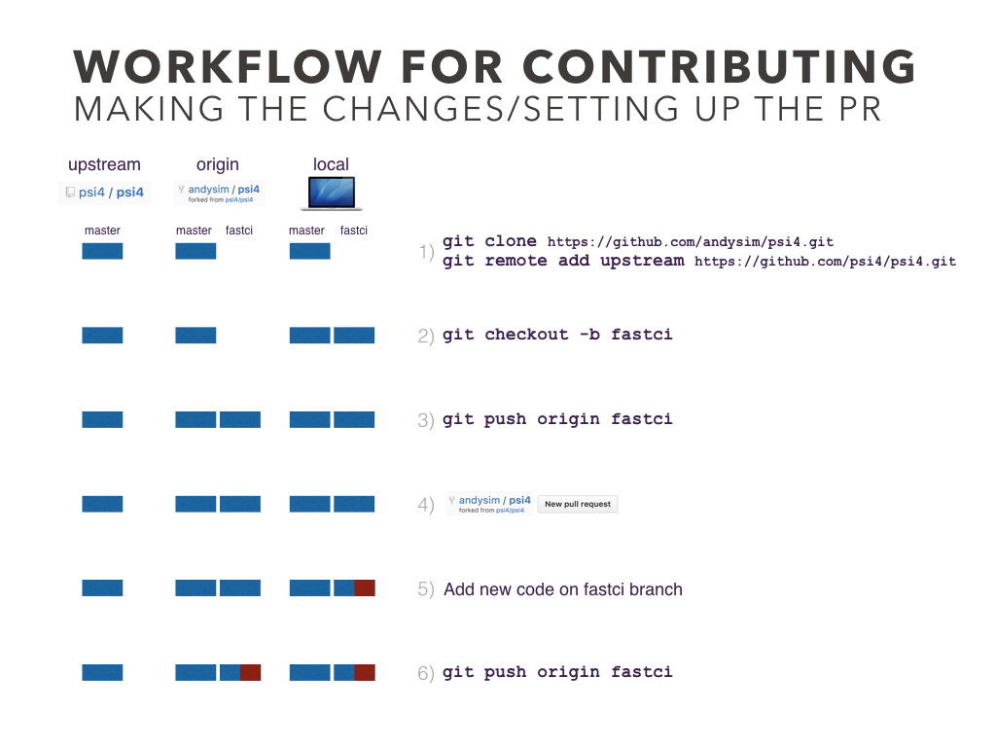

Slide 39
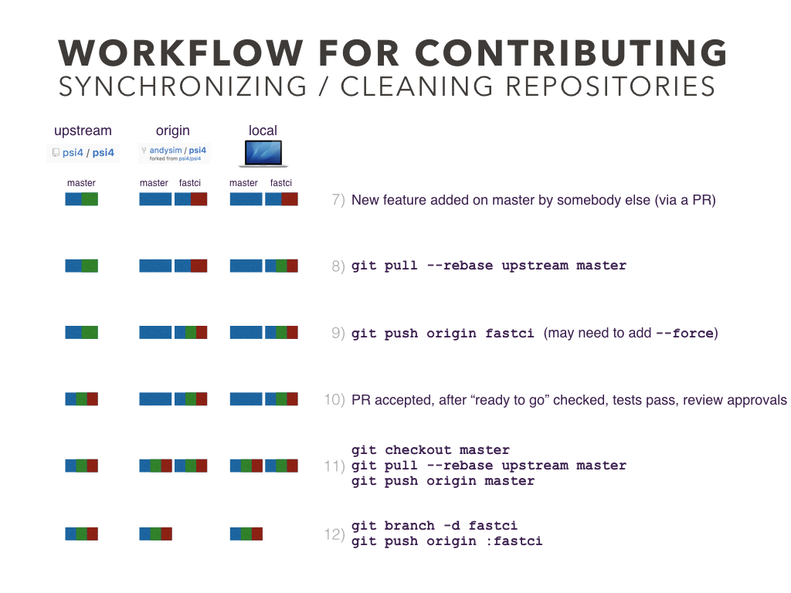

Slide 40
A Quick Git Demo
Afterwards I’ll show basic (local) git usage. Note that when you use a command like git pull origin master. Origin is just a remote location configured by git clone for you automatically. Similarly git pull . master would refer to the master branch of the current local repo.
I’ll also show rebasing and interactive history editing. In the video I’ll create a git repo, create a branch, add a few commits to the original branch, and then reconcile two branches that have diverged. Then I’ll squash some of the commits. There is a lot more to git that you can learn and use.
I’ll show at the end that for git push the full(er) syntax is git push location source:destination. It is good practice not to force push but not forbidden check with your dev team in case it becomes necessary (merging will often make it necessary)

Slide 43
grep and (neo)vi(m)
How to write regular expressions to search output files or accelerate vi tasks.
grep, vi, python, c++, rust, all have tools for using regexes

Slide 44
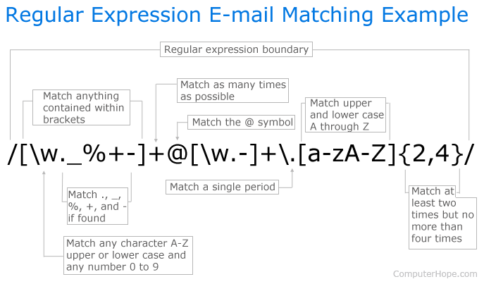
Regular Expressions
Regexes use a series of special characters and sequences to match substrings of text.
RegExr / regex101 web utilities to play with regexes.

Slide 45
vim
I can’t recommend enough that you learn and adjust to vim and living in your terminal. Many people love beamer; however, when you get to writing your dissertation or really large projects you are going to run into issues with compiling. You can set up a vim environment that offers all the features beamer has and more: autocompleting, syntax highlighting, automatic pdf updating, spell checking, compiling via vim command, etc…
Look into a vim plugin manager and install vimtex with a decent pdf viewer like okular.

